Slide 1

Pessimistic and Optimistic Locking in JPA, Spring Boot

Slide 2
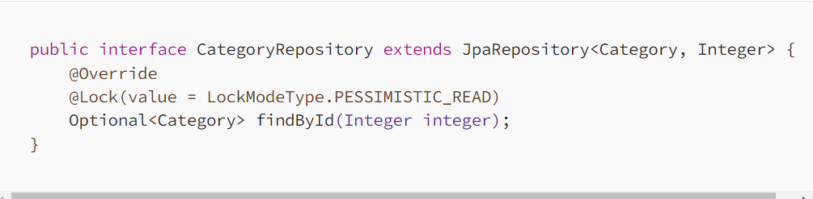
Pessimistic Locking in JPA
PESSIMISTIC_READ
PESSIMISTIC_WRITE
PESSIMISTIC_FORCE_INCREMENT.
PESSIMISTIC_READ

Slide 3
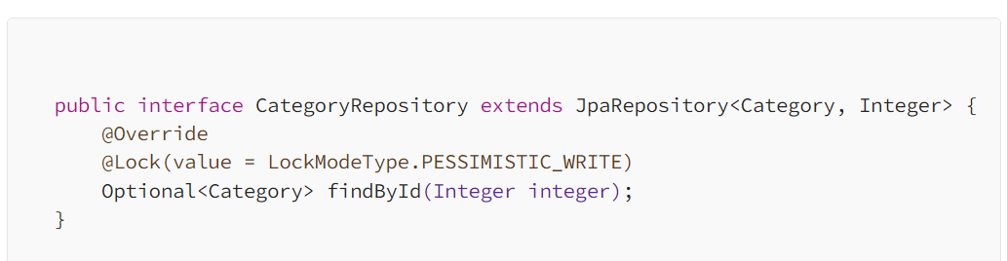
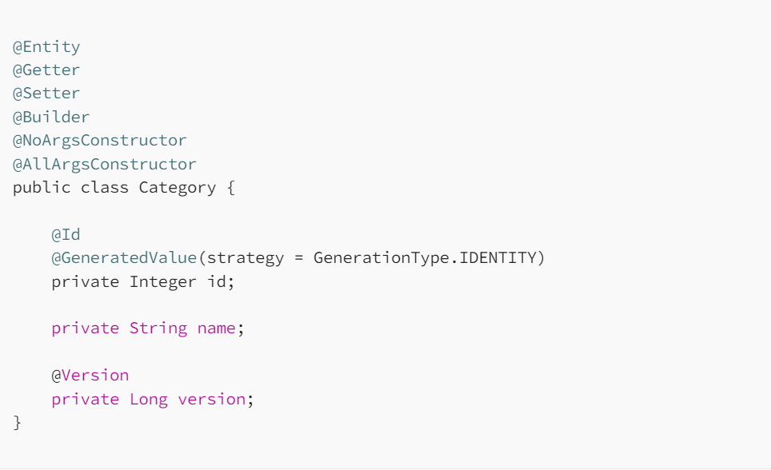
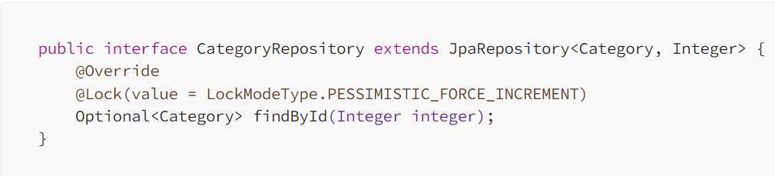
PESSIMISTIC_WRITE
PESSIMISTIC_FORCE_INCREMENT

Slide 4
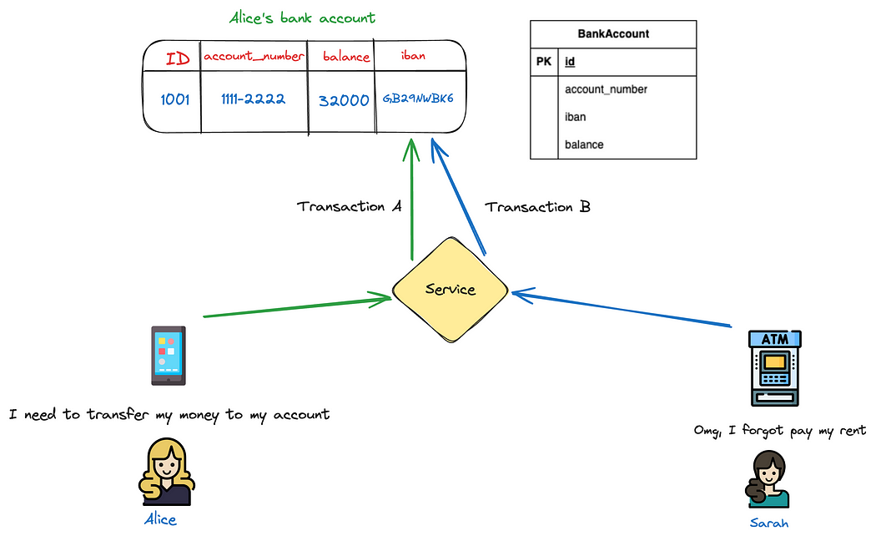
Optimistic Locking

Slide 5
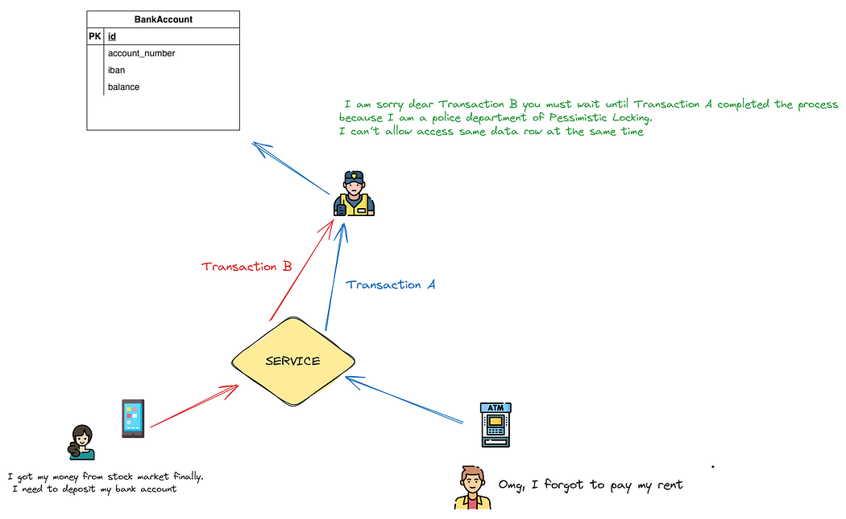
Pessimistic Locking

Slide 6
Optimistic
Some rules for the declaration of a version attribute must be followed.
Each entity class must have a version attribute
Each table must have a version column
The type of version must be numeric such as Integer, Short, or Long

Slide 7
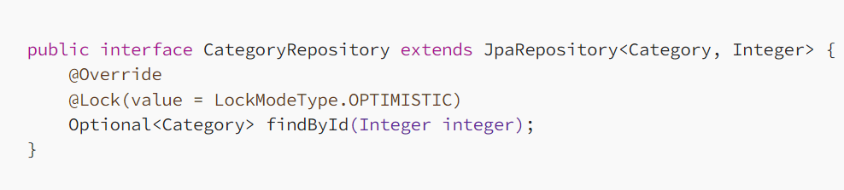
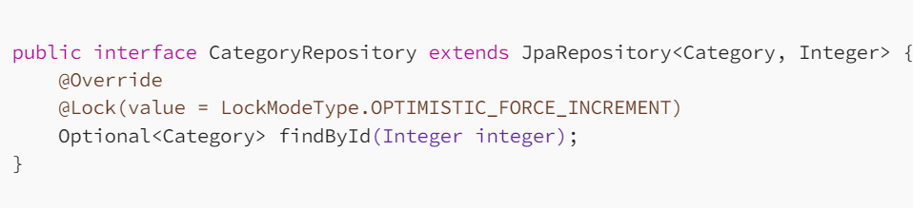
OPTIMISTIC
OPTIMISTIC
OPTIMISTIC_FORCE_INCREMENT

Slide 8
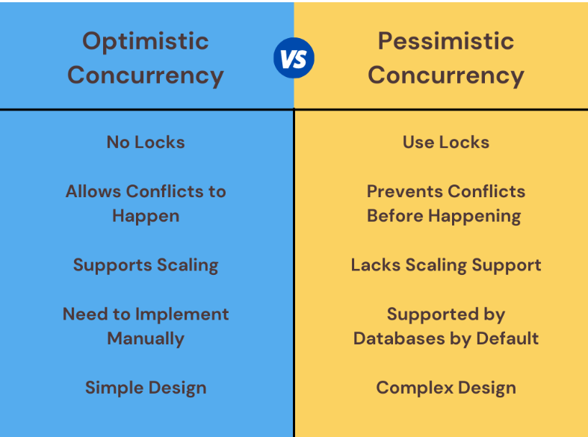
Optimistic Vs Per

Slide 9
Spring security with JWT

Slide 10
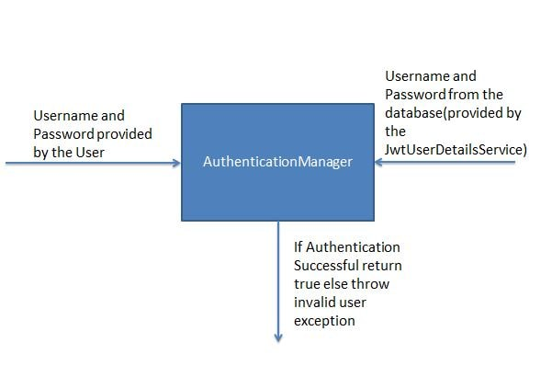
Authentication Manger

Slide 11
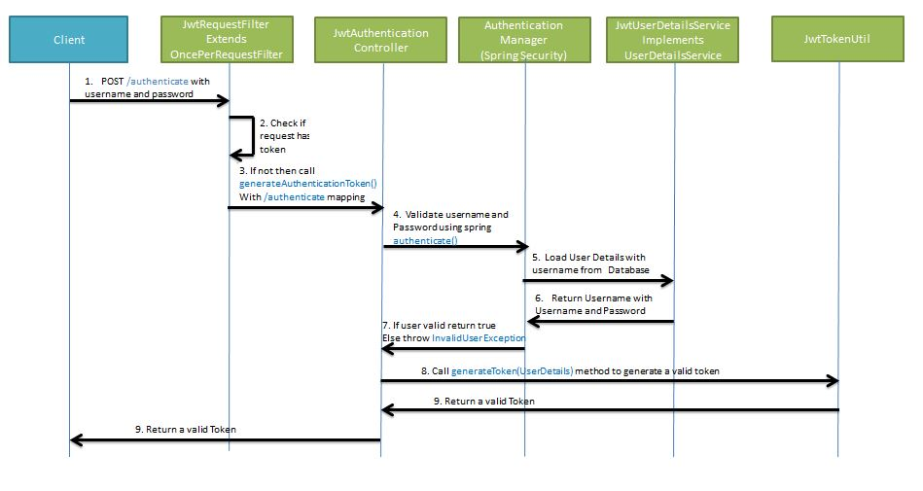
Generating JWT

Slide 12
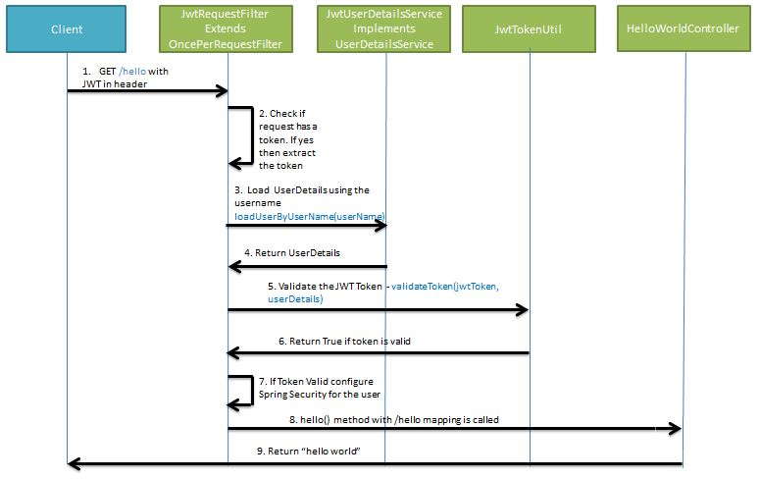
Validating JWT

Slide 13
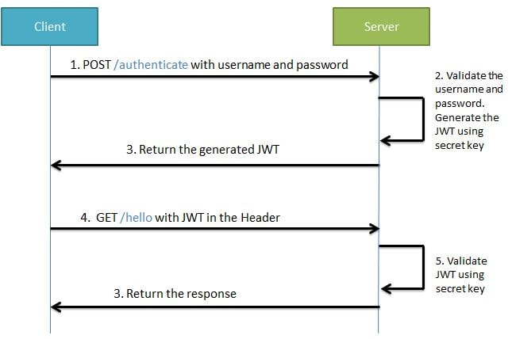
REST API with JWT Token

Slide 14
Spring Cloud

Slide 15


Slide 16
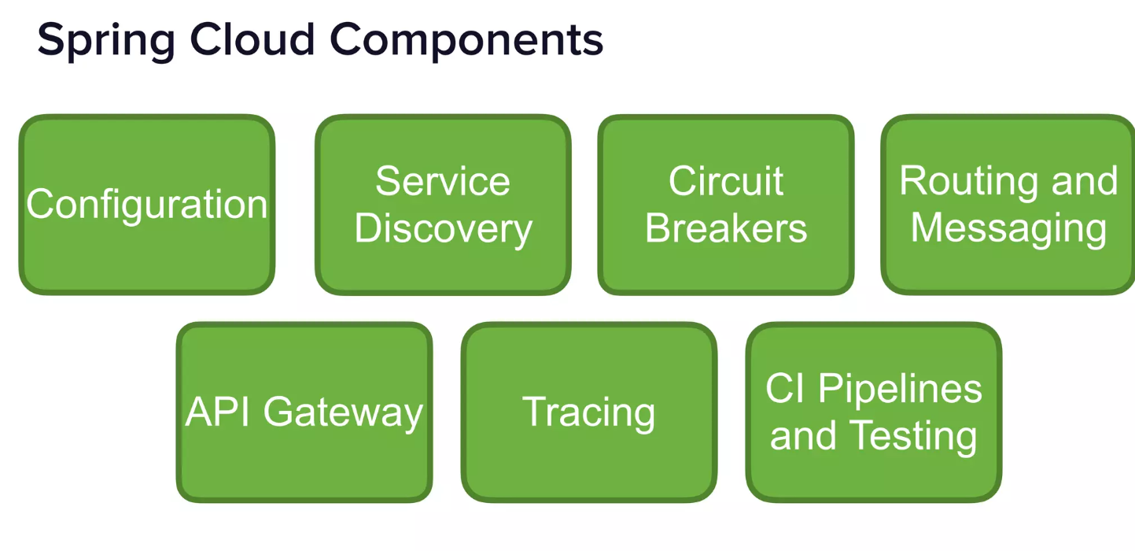

Slide 17


Slide 18
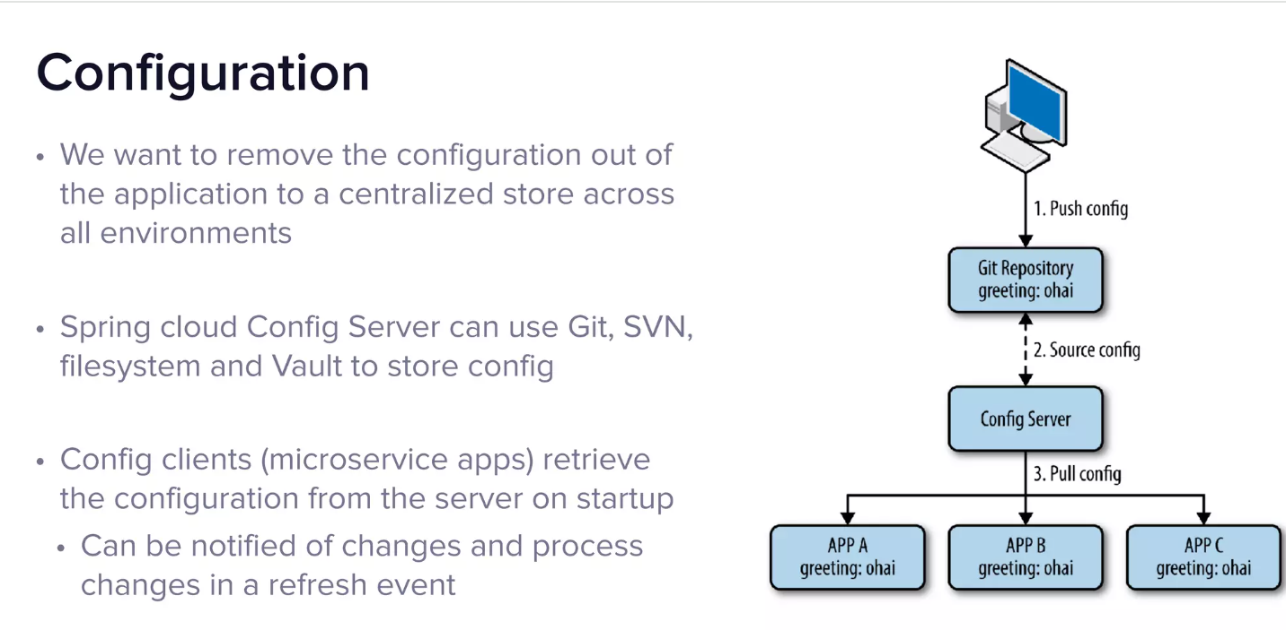

Slide 19
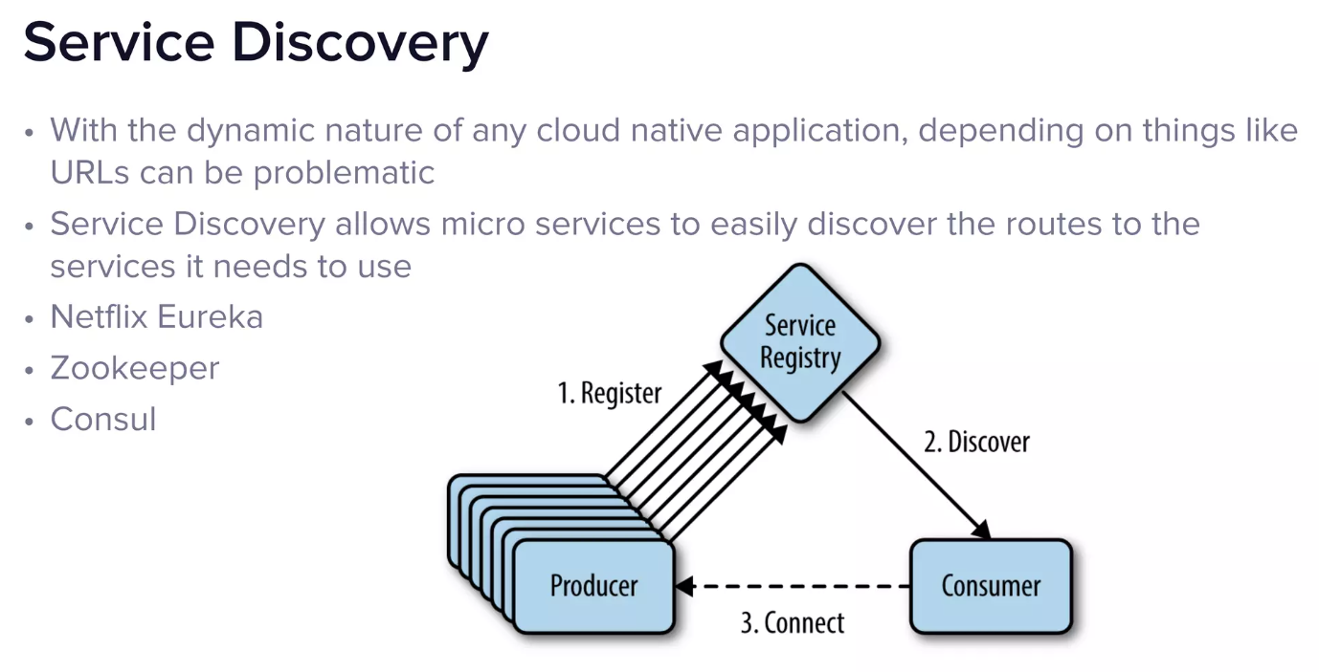

Slide 20
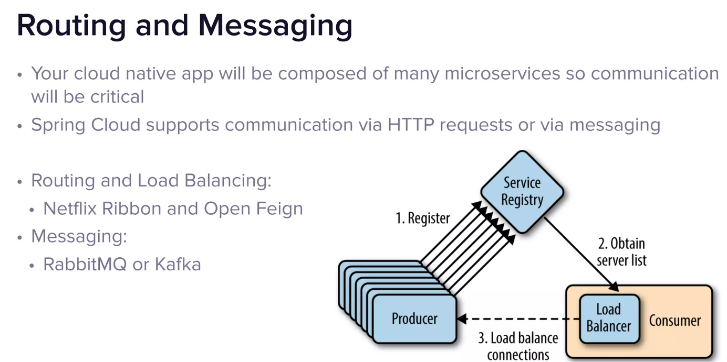

Slide 21
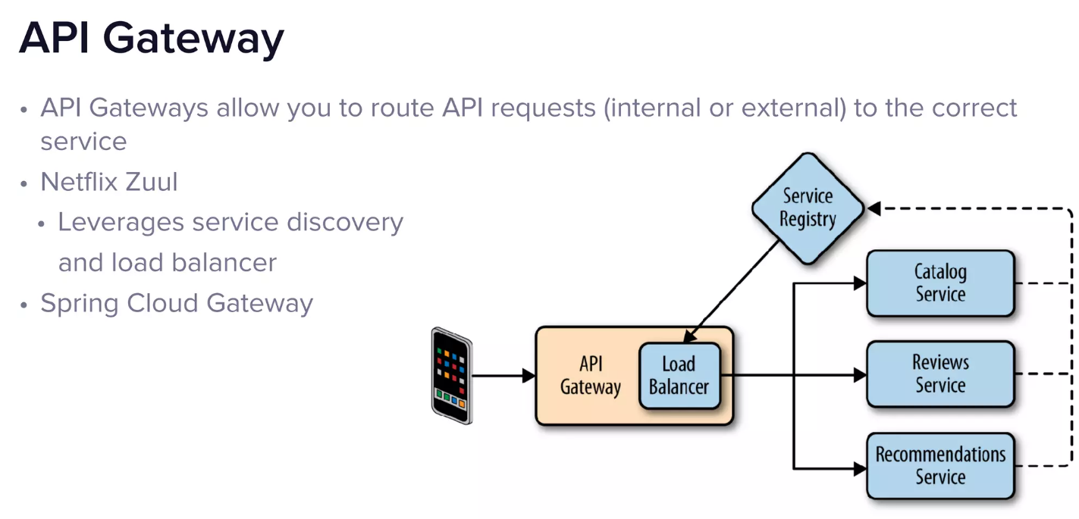

Slide 22
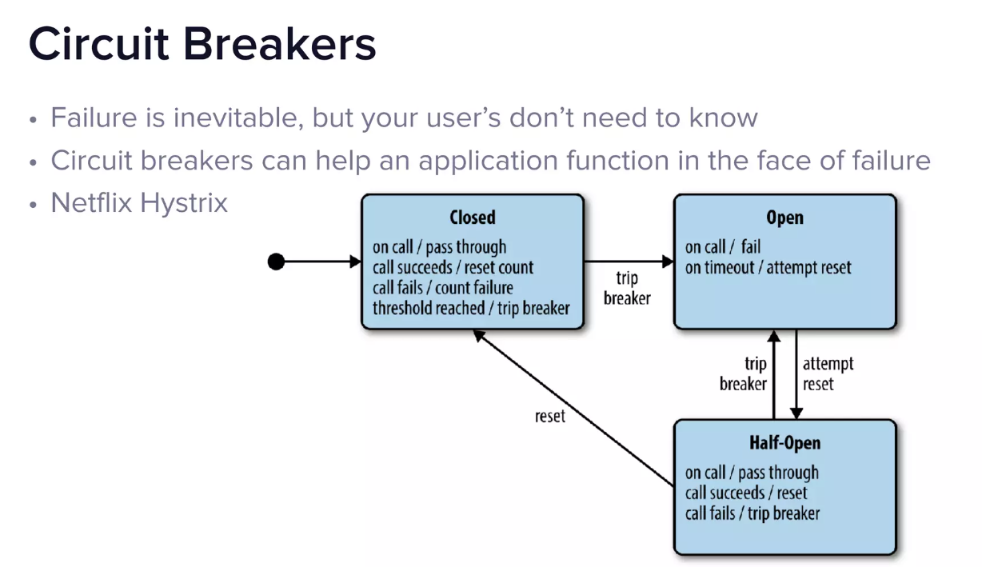

Slide 23
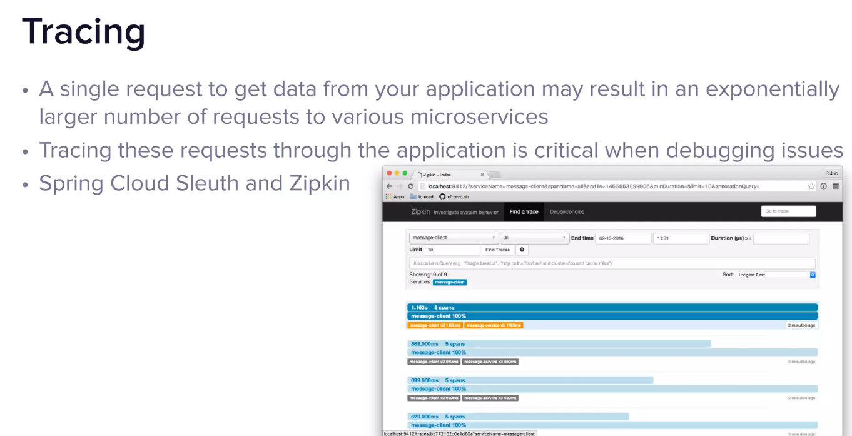

Slide 24
